Slide 1
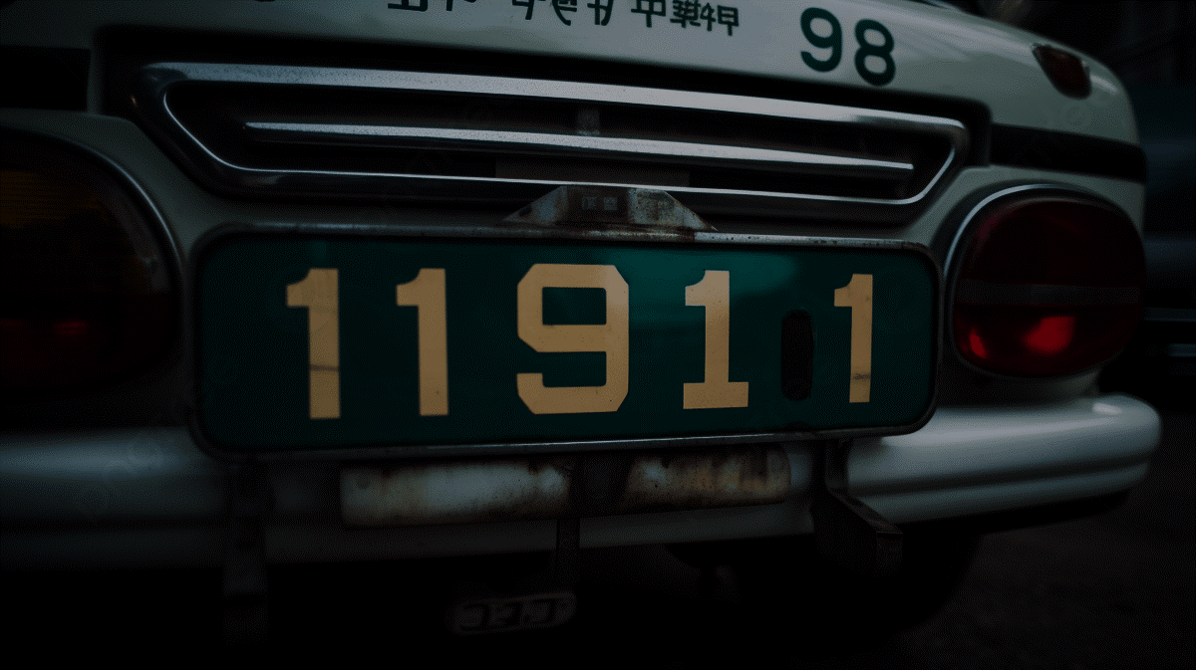
ALPR and Owner Detail Fetching
Mini Project Presentation
Presented by- Mohammed Anas
Guide Name- Prof. Sheera Shamsu
Date- 8th November 2024
Roll No- MCA23-142

Slide 2

Introduction
Develops an efficient ALPR system tailored for Indian vehicles.
Addresses challenges like noise, low light, varying fonts, and plate orientations.
Uses image preprocessing techniques: morphological transformations, Gaussian filtering, thresholding, and edge detection.
Segments number plates using contour analysis and character filtering.
Applies OCR for accurate character recognition from isolated segments.

Slide 3
Problem Statement
Develop an Automatic Number Plate Recognition (ANPR) System using YOLOv4, OpenCV, and OCR to detect and recognize license plates with high accuracy. The system will:
Process images (captured/uploaded) for license plate extraction.
Access a MySQL database to:
Retrieve existing vehicle owner details automatically.
Allow new entries when details are missing.
Enable real-time vehicle tracking for security and regulatory purposes.
This solution aims to streamline vehicle identification and owner verification processes.

Slide 4
Literature Survey
Title | Authors | Algorithm | Year of Publication | Site
License Plate Recognition Using YOLO and Tesseract OCR | IJCRT | YOLO and Tesseract OCR | 2024 | IJCRT
Vehicle License Plate Detection and Recognition using OpenCV and Tesseract OCR | W. R. Sania, C. A. Sari, E. H. Rachmawanto, and M. Doheir | OpenCV, Tesseract OCR | 2023 | International Journal on Advanced Science, Engineering and Information Technology
Extracting Information from Vehicle Registration Plate using OCR Tesseract | Agung Yuwono Sugiyono et al. | Image processing and Tesseract OCR | 2023 | ScienceDirect

Slide 5
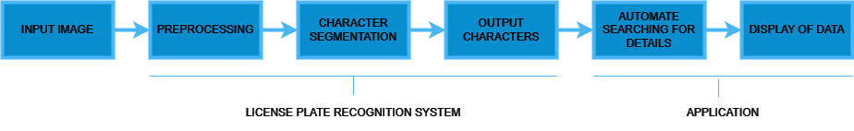
Methodology

Slide 6



Proposed System
Check for Owner Details
or
Add Owner Details
Extract Number Plate
Input Image
Retrieve & Display Results

Slide 7

Future Enhancement
Check for Owner Details
Via Authorized API
Extract Number Plate
Input Image
Retrieve & Display Results

Slide 8
Future Enhancement
Video Processing
Enable real-time detection for moving and stationary vehicles from video feeds. This improves usability in diverse conditions like traffic surveillance.
Authorized Government API Integration
Utilize APIs from sites like API Setu for instant, official data. This ensures accurate and up-to-date owner information.
AI-Powered Image and Video Enhancement
Use AI to enhance blurred or damaged images, improving recognition accuracy. This makes detection reliable in poor-quality footage.

Slide 9

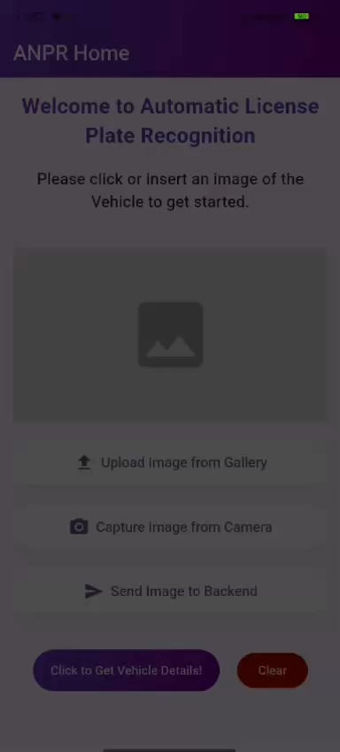
Output Screen Recording

Slide 10
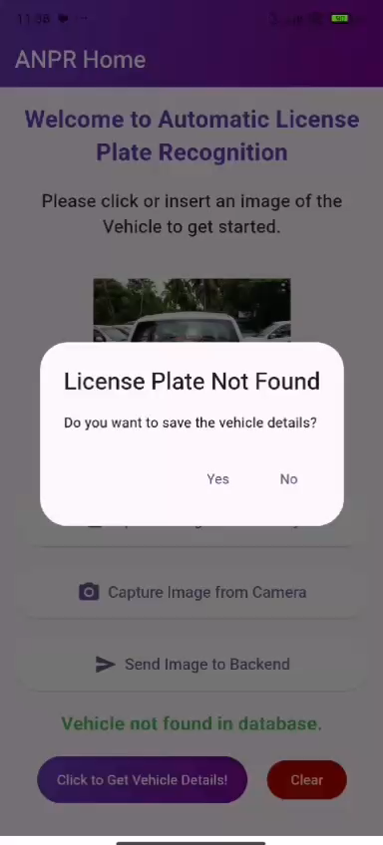
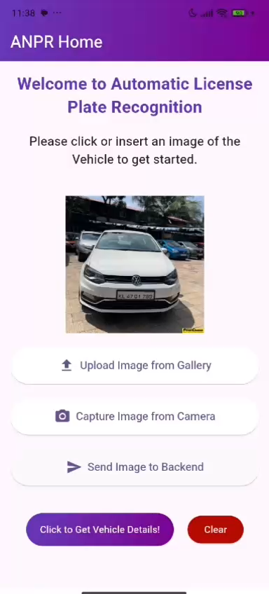
Output Screen Recording

Slide 11

Thank You

